Slide 1
IT 106: Introduction to IT Problem Solving Using Computer Programming
Module 2a
Developing Algorithms

Slide 2
In This Lecture
Problem Definition
Designing a Solution Algorithm
More Problems

Slide 3
Questions?

Slide 4
Problem Definition

Slide 5
Defining the Problem
BEFORE we do anything else, we must understand what is the problem we are trying to solve
This is the first step in the development of a computer program!

Slide 6
Defining the Problem (Cont'd)
How to understand the problem
Carefully reading and re-reading the problem until it is completely understood
Additional information may need to be sought to help resolve deficiencies and ambiguities in the problem specification
Example: Read some numbers, add them together, and print their total

Slide 7
Defining the Problem (Cont'd)
Problem should be divided into three separate components
Input: A list of source data provided to the problem
Usually identified by descriptive words: nouns and adjectives
Output: A list of the outputs required
Usually identified by descriptive words: nouns and adjectives
Processing: A list of actions needed to produce the required outputs
Usually identified by verbs and adverbs

Slide 8
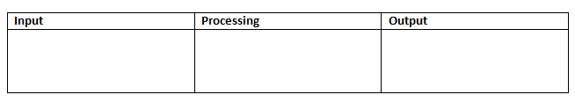
Defining the Problem (Cont'd)
Sometimes the input, output, and processes are not clearly defined
In this case, focus on the required output and work backwards
It is helpful to put the input, output, and processes into a definition diagram

Slide 9
Questions?

Slide 10
Example 1: Defining the Problem
Problem: The program is required to read three numbers, add them together, and print their total
What is the input, output, and processes?

Slide 11
Example 1: Defining the Problem (Cont'd)
Problem: The program is required to read three numbers, add them together, and print their total
Input
Remember, input describes what we have to provide to the program
number1
number2
number3

Slide 12
Example 1: Defining the Problem (Cont'd)
Problem: The program is required to read three numbers, add them together, and print their total
Output
Remember, outputs describe what we expect the program to provide upon completion
total

Slide 13
Example 1: Defining the Problem (Cont'd)
Problem: The program is required to read three numbers, add them together, and print their total
Processes
Remember, processes describe what we have to do get to the expected output
read three numbers
add them together
print their total

Slide 14
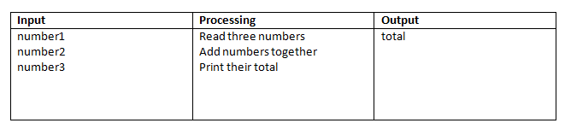
Example 1: Completed Definition Diagram

Slide 15
Questions?

Slide 16
Designing a Solution Algorithm

Slide 17
Designing a Solution Algorithm
Once the problem is clearly defined, an algorithm must be created to show how the problem will be solved
Most difficult task in the lifecycle of program creation!
1st attempt usually does not result in a finished product
The more complex the problem, the more likely the chance for logic errors
Pseudocode is useful in a trial-and-error process where it is relatively easy to add, change, or delete instructions

Slide 18
Designing a Solution Algorithm (Cont'd)
Reminder! If the algorithm is not correct, the program will never be correct
It is important not to start coding until you have adequately defined the problem and designed a solution algorithm that meets the problem requirements

Slide 19
Creating the Solution Algorithm
The defining diagram shows what is required
The solution algorithm shows how the input is processed to achieve the output
Pseudocode can be used to show how to achieve the output

Slide 20
Creating the Solution Algorithm (Cont'd)
Defining Diagram
Solution Algorithm in Pseudocode
ADD_THREE_NUMBERS
1 Read number 1, number2, number3
2 Set total = number1 + number2 + number3
3 Print total
END

Slide 21
Checking the Solution Algorithm
After a solution algorithm has been established, it must be tested for correctness
Required because most major logic errors occur during the development of the algorithm
It is easier to detect and fix errors in pseudocode than within the constructs of the programming language

Slide 22
Using Desk Checking
Desk checking – tracing through the logic of the algorithm with some chosen test data
Walk through the logic of the algorithm exactly as a computer would, keeping track of all major variables' values on a sheet of paper
Helps detect errors early and allows the user to become familiar with the way the program runs

Slide 23
Selecting Test Data
To identify appropriate test data
Investigate program specifications and choose simple test cases based on the requirements specifications, not the algorithm
Concentrate on what the program is supposed to do, not how it is going to do it
Only a few simple test cases are needed to test the major parts of the algorithm logic
Also consider bounds-testing
Ensuring your program will not break when unexpected data is entered

Slide 24
Steps in Desk Checking an Algorithm
Steps
Choose simple input test cases that are valid
Establish the expected result for each test case
Make a table on a piece of paper of the relevant variable names within the algorithm
Walk the first test case through the algorithm
Repeat the walkthrough process using other test data
For each case, check the expected result established in Step 2 matches the actual in Step 5
Also consider bounds-testing aside from desk checking

Slide 25


Example 1: Desk Checking
Choosing two sets of input test data
Establish the expected result for each test case

Slide 26
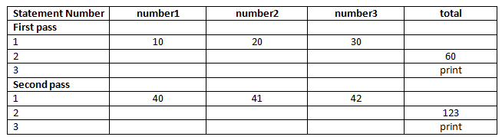
Example 1: Desk Checking (Cont'd)
Make a table on paper of the relevant variable names within the algorithm and walk through the test cases
Check the expected results match the actual results
If they do, you are ready to convert to a programming language
If not, you need to check the algorithm for logic errors

Slide 27
Questions?

Slide 28
More Problems

Slide 29
Example 2: Defining the Problem
Problem: Sally wants to know how long it will take to cut the grass around her house. She lives in a rectangular house on a rectangular house block. She can cut her grass at the rate of 2 square meters/minute.
What is the input, output, and processes?

Slide 30
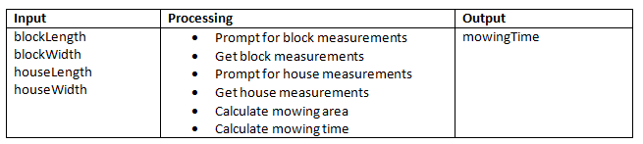
Example 2: Completed Definition Diagram

Slide 31
Example 2: Solution Algorithm
BEGIN CALCULATE_MOWING_TIME
1 Prompt user for blockLength, blockWidth
2 Get blockLength, blockWidth
3 Set blockArea = blockLength * blockWidth
4 Prompt user for houseLength, houseWidth
5 Get houseLength, houseWidth
6 Set houseArea = houseLength * houseWidth
7 Set mowingArea = blockArea – houseArea
8 Set mowingTime = mowingArea / 2
9 Print mowingTime to screen
END

Slide 32
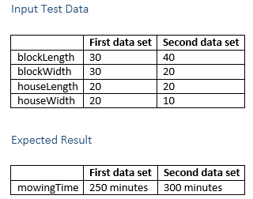
Example 2: Desk Checking

Slide 33
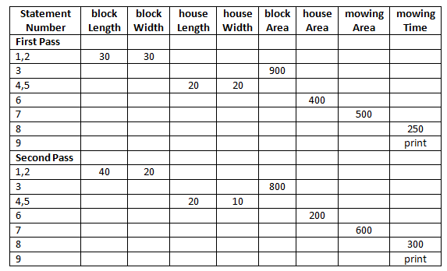
Example 2: Desk Checking (Cont'd)

Slide 34
Practice Problem
Scenario
For an IT course, the Syllabus states the final grade is calculated as an average of four, equally weighted exams. A program is required to prompt the instructor to enter the grades for each of the exams, which will then calculate and display to the screen the final numerical grade
To Do:
Create a defining diagram
Create a solution algorithm using pseudocode
Check the solution algorithm by using the desk checking table method

